Slide 1
70-530 Data Visualization
Week 3 - Encodings

Slide 2
Objectives
How to applying encodings well
Using color theory to guide encoding considerations
Theory of design - Gestalt Rules

Slide 3
Appropriate Encodings for Data Visualization

Slide 4
Appropriate Encodings for Data Visualization
Important to consider visual properties of encodings:
Color
Size
Shape
Lines
Text

Slide 5
Color - Theory

Slide 6
Color Theory
Trichromacy Theory
3 distinct color receptors (cones)
these function at normal light levels
Eyes also have rods
these function at low light levels
overstimulated at normal light levels, so color can perception is marginal

Slide 7
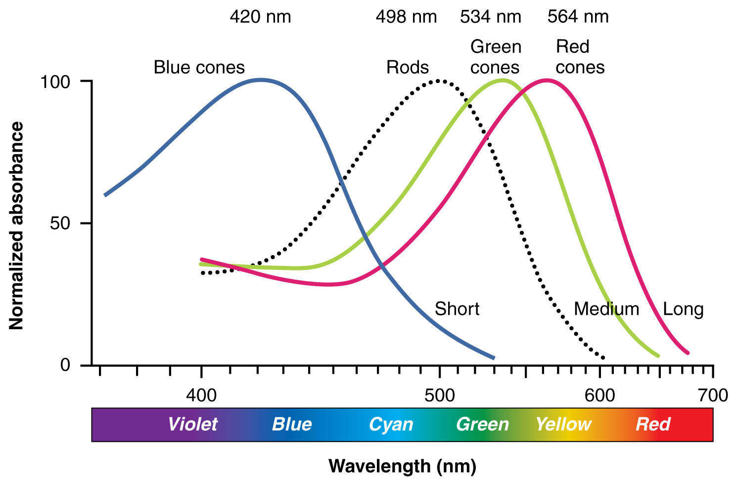
Color Theory
Notes:
By OpenStax College - Anatomy & Physiology, Connexions Web site. http://cnx.org/content/col11496/1.6/, Jun 19, 2013., CC BY 3.0, https://commons.wikimedia.org/w/index.php?curid=30148003

Slide 8
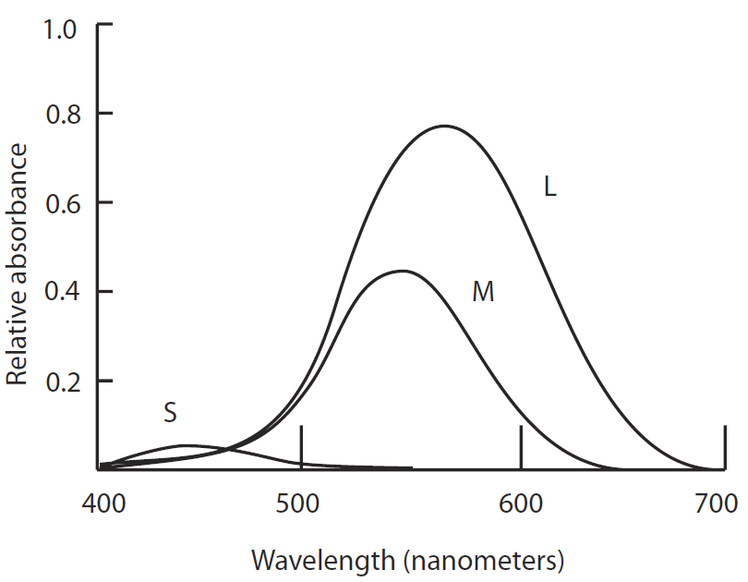
Color Theory
Relative absorbance
Short-wavelength (S) receptors absorb blue light,
but are much less sensitive than other receptors
Reason for not showing detailed info in pure blue on black

Slide 9
Color Theory
3 receptors
Brain can perceive the three primary colors
Can also perceive differences between them
Results in a 3D color space

Slide 10
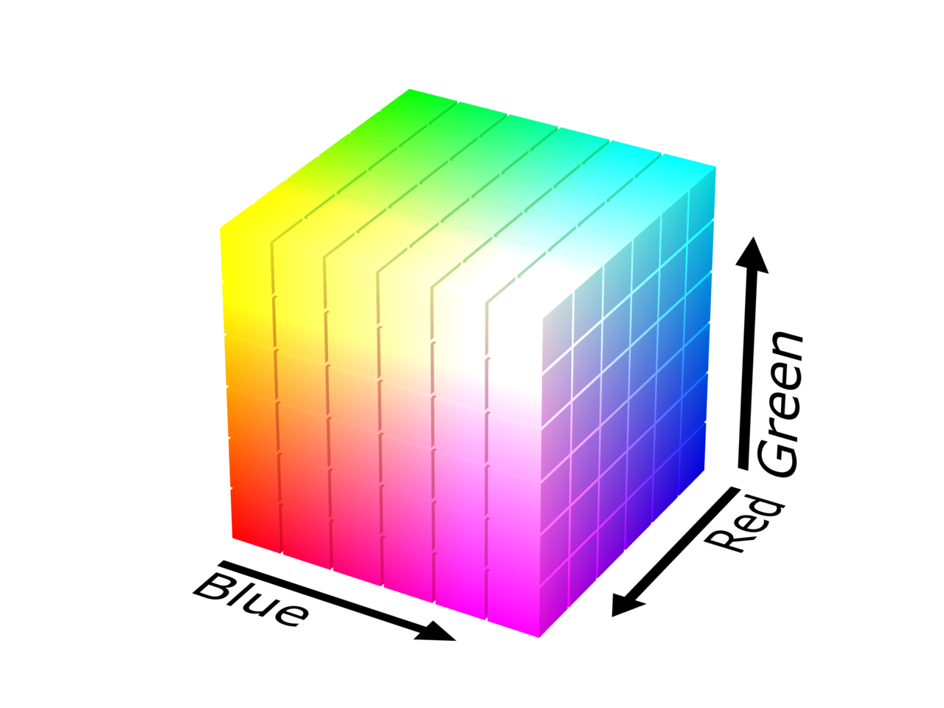
Color Theory
Color space can have different representations
Colorimetry - science of quantifying color perception
One way: RGB-space
C = rG + gG + bB

Slide 11
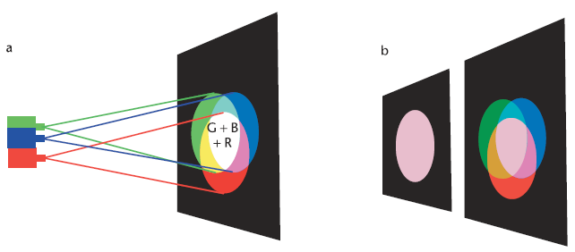
Color Theory
Example of producing different colors by mixing RGB
Gamut - set of all colors that can be produced by a device or sensed by a receptor system
Notes:
A color-matching setup. (a) When the light from three projectors is combined, the results are as shown. Yellow light is a mixture of red and green. Purple light is a mixture of red and blue. Cyan light is a mixture of blue and green. White light is a mixture of red, green, and blue. (b) Any other color can be matched by adjusting the proportions of red, green, and blue light.

Slide 12
Color Theory
Primary colors can differ:
Monitors: RBG (red, green, blue)
Printers: CMY (cyan, magenta, yellow)
Only colors within gamut are reproducible
Example: yellow, blue, purple would have a smaller gamut

Slide 13
Color Theory
CIE System of Color Standards
defined quantitative links between physical pure colors (i.e. wavelengths) in the electromagnetic visible spectrum, and physiological perceived colors in human color vision
allow one to translate different physical responses to visible radiation in color inks, illuminated displays, and recording devices such as digital cameras into a universal human color vision response
Based on a standard observer - hypothetical person whose color sensitivity functions are held to be typical of all humans
Notes:
The International Commission on Illumination (usually abbreviated CIE for its French name, Commission internationale de l'éclairage) is the international authority on light, illumination, colour, and colour spaces. It was established in 1913 as a successor to the Commission Internationale de Photométrie and is today based in Vienna, Austria. The President from 2015 is Yoshihiro Ohno from the US. (wikipedia - International Commission on Illumination)

Slide 14
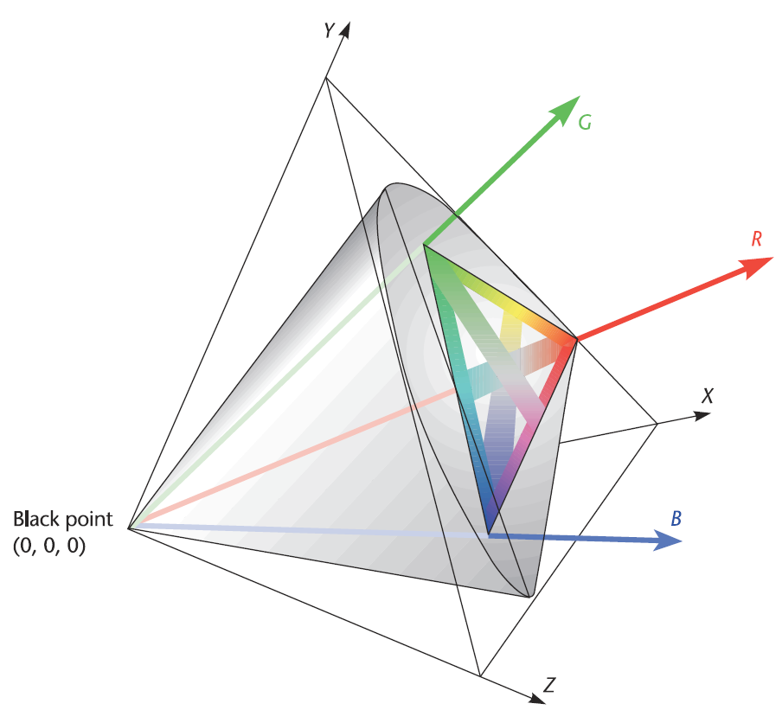
Color Theory
The X, Y, and Z axes represent the CIE standard virtual primaries.
Notes:
The X, Y, and Z axes represent the CIE standard virtual primaries. Within the positive space defined by the axes, the gamut of perceivable colors is represented as a gray solid. The colors that can be createdby means of the red, green, and blue monitor primaries are also shown.

Slide 15
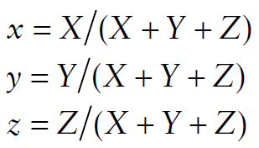
Color Theory
XYZ coordinates
can be transformed to chromaticity coordinates (xyz)
Defines hue and vividness of color
Ignores amount of light (lightness or luminance)

Slide 16
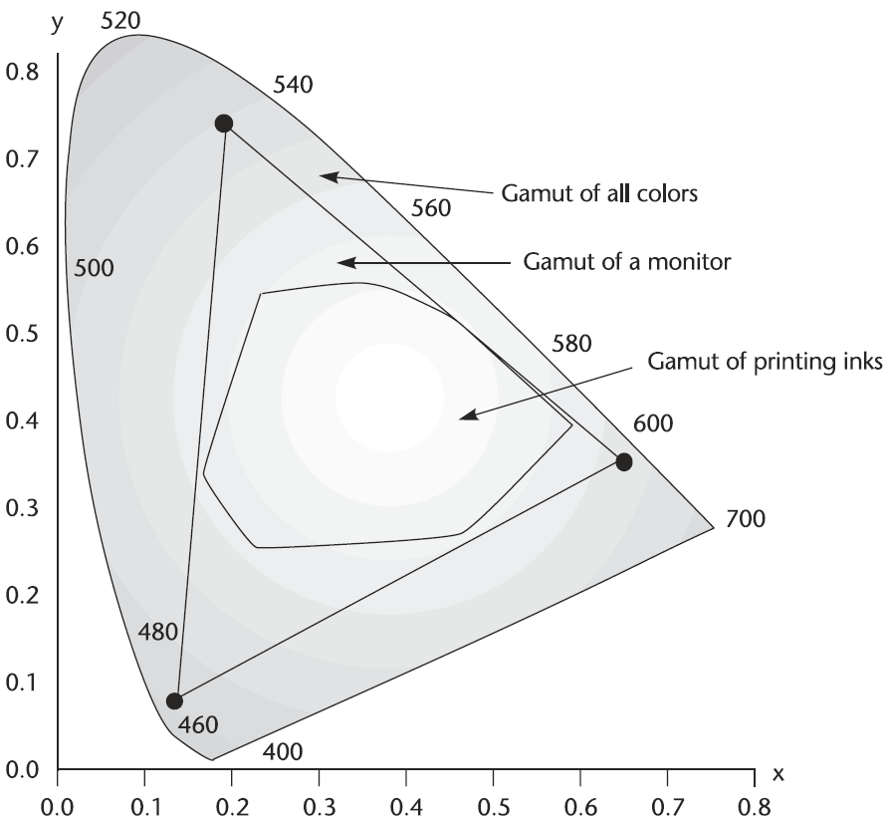
Color Theory
Notes:
CIE chromaticity diagram with various interesting features added. The triangle represents the gamut of a computer monitor with long-persistence phosphors.

Slide 17
Design Rules for Using Color

Slide 18
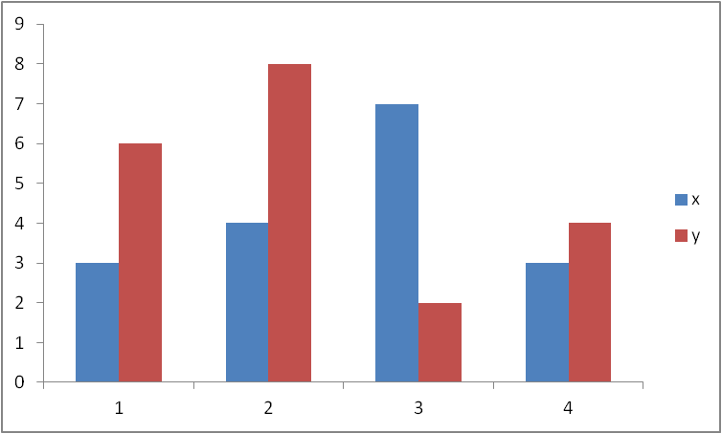
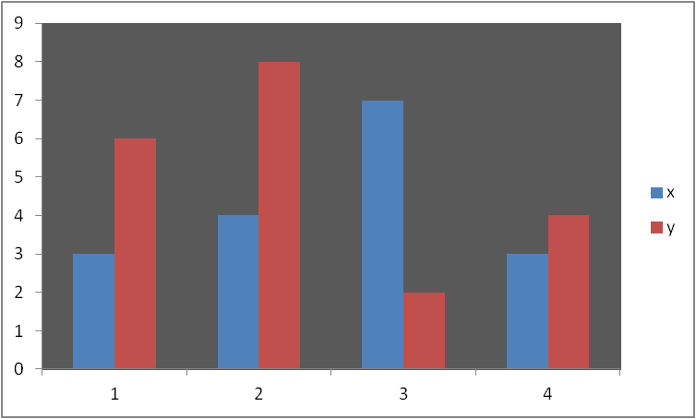
Color
Some consequences of color theory:
To show detail in a visualization, always have considerable luminance contrast between foreground and background information.

Slide 19
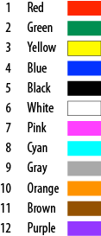
Color
Hue is not naturally ordered
avoid using for ranking or ordering of data
can use brightness or saturation instead
Hue is good for categorical data
but only for small number of categories
6-12 categories is OK, but up to 20 is possible
Notes:
The first four colors (red, green, yellow, and blue) are primary in the brain, so should be used first.

Slide 20
Color
When a perceptually meaningful ordering is needed, use a sequence that varies monotonically on at least one of the opponent color channels.
Examples:
red to green
yellow to blue
low saturation to high saturation
dark to light / light to dark
Variation on more than one channel is often better, such as pale yellow to dark blue.

Slide 21
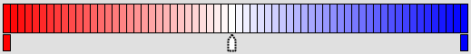
Color
If it is important to show variations above and below zero, use a neutral value to represent zero and use increases in saturation toward opposite colors to show positive and negative values.

Slide 22
Color
Leverage common color association:
Purple - royalty / magic
Brown - dirt / leather / stone / “earthiness”
Orange - fire / energy / health / vigor
Green - nature / earth/ environment / “green light”
Blue - water / coolness/ calm
Black - mourning / luxury
Pink - affection / imagination / young girl
Yellow - happiness / sunshine (too much is bad)
White - purity / sympathy
Red - warning / danger / passion
Gray - neutrality / conservatism / modesty
Notes:
In the East, red has a good luck and prosperity association.

Slide 23
Color
Color choices need to be compatible with learned associations
Otherwise - cognitive interference

Slide 24
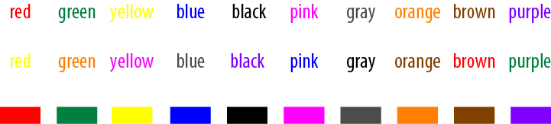
Color
Stroop Test (John Ridley Stroop, 1935):
Notes:
Second line takes longest to read due to cognitive interference.

Slide 25
Other Properties of Encodings

Slide 26
Size
Size can be used to great advantage to represent the relative importance of entities
Draw central, key entities relatively larger to draw attention

Slide 27
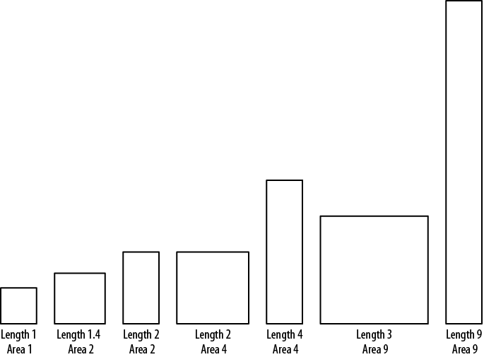
Size
Perception of relative size is harder when difference is in multiple dimensions
We tend to underestimate differences
between rectangles of various width and height
Notes:
a square that is 1.4 units long on each side has twice the area of a square with sides of length 1, but doesn’t seem “twice as big”

Slide 28
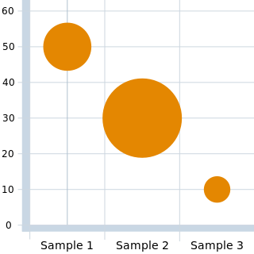
Size
Circular shapes can also be compared
But perception is harder than for rectangles
Important - represented quantities should vary the area of the bubble, not diameter or radius
Notes:
By Sylvielmna - http://en.wikipedia.org/wiki/File:Adobe_Flex_BubbleChart.png, CC BY-SA 1.0, https://commons.wikimedia.org/w/index.php?curid=19834407

Slide 29
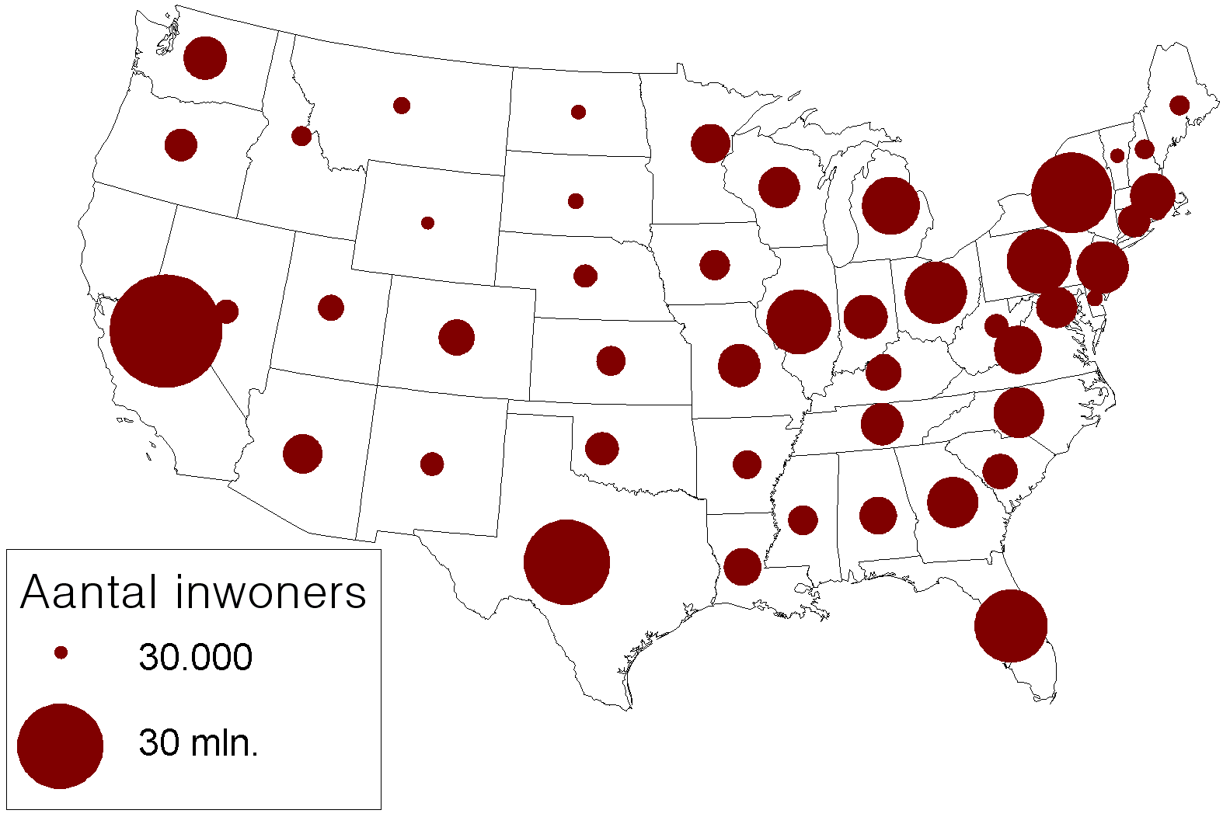
Size
Circular comparisons in a bubble plot
Notes:
By Nijeholt at Dutch Wikipedia, CC BY-SA 3.0, https://commons.wikimedia.org/w/index.php?curid=3223488

Slide 30
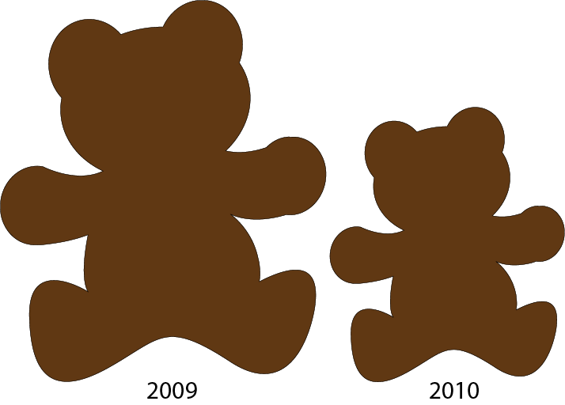

Size
Irregular shapes are hard to compare (in terms of area)

Slide 31
Text and Typography
Most visualizations use some text
Examples: titles, axis labels, data point labels, legends
#1 rule - text needs to be readable

Slide 32
Text and Typography
Use sufficient font size
Don’t use too much text (e.g. increase axis marks)
Use appropriate fonts
Generally, serif fonts (e.g., Times) for blocks of text
Sans sarif fonts (e.g., Arial) for titles, tags, and labels
No fancy fonts (e.g. Comic Sans)
Be consistent

Slide 33
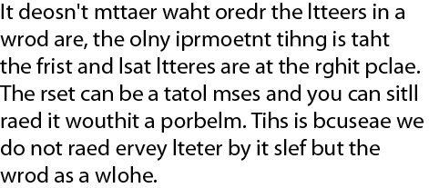
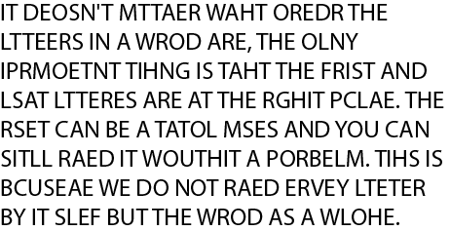
Text and Typography
Text in all caps may be harder to read

Slide 34
Shape
Shape is a very useful property for labeling or encoding categories
Large variety of shape available
Easy to differentiate
Can be more evocative than other properties
Can have significant cultural implications (think crosses, crescents, stars, shields, etc.)

Slide 35
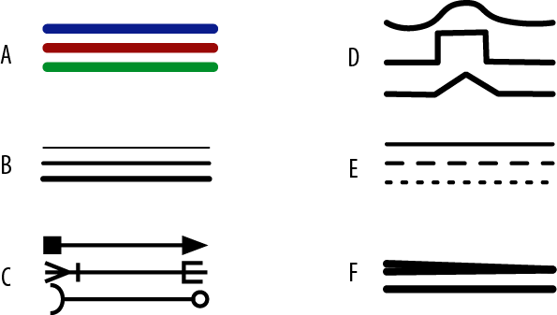
Lines
Lines that connect other entities are excellent for representing all sorts of relationships
Can show many different qualitative factors (e.g. quantity or volume of flow)
Can have different visual properties:
Color
Weight
Endings
Pattern
Path
Taper

Slide 36
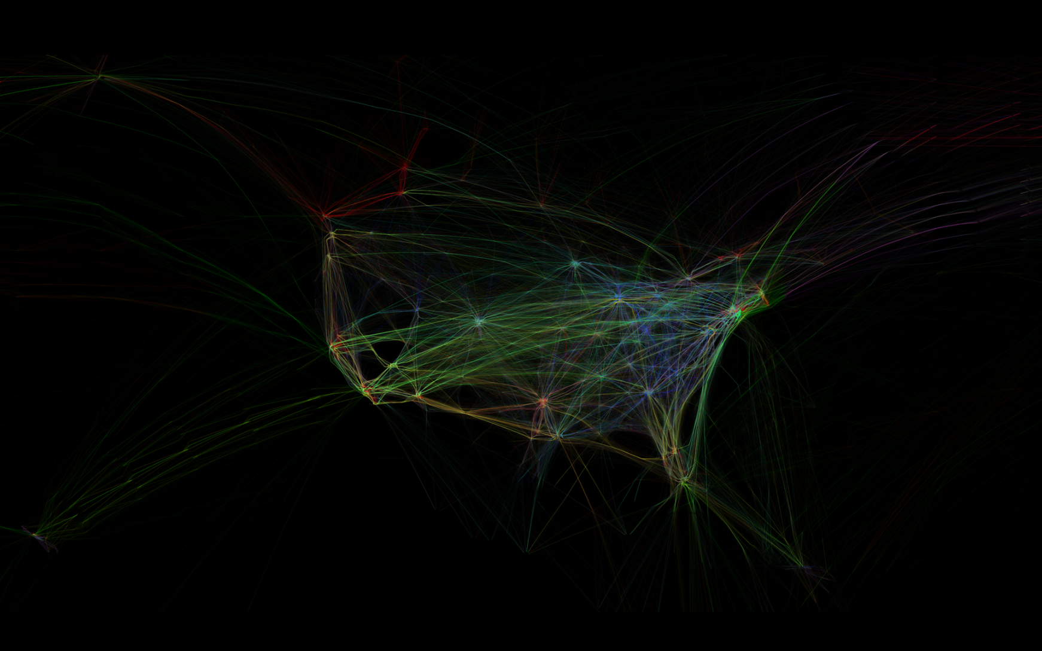
Lines
Lines are not always needed (may add noise)
Notes:
http://www.aaronkoblin.com/work/flightpatterns/4_1920.png

Slide 37
Labels
Keys vs. Direct Labeling
Keys (legend) - good when many data points exist
Direct labeling - good for few data points
Speeds up visual search (no need for lookup)
Can be distracting when needing to label many points

Slide 38
Application of Encodings - Theory

Slide 39
Application of Encodings - Theory
Good application of encodings depend on perception
Involves looking for patterns by making visual queries
Can be vague (trying to identify any structure)
or specific (e.g. looking for a specific trend)
Most compelling reason for visualization:
Seeing patterns can lead to key insights

Slide 40
Application of Encodings - Theory
Some key questions:
What does it take for us to see a group?
How can 2D space be divided into perceptually distinct regions?
Under what conditions are two patterns recognized as similar?
What constitutes a visual connection between objects?

Slide 41
Design Rules
Pattern perception knowledge -> abstract design rules
Design rules: how to organize data so that important structures are easily perceived

Slide 42
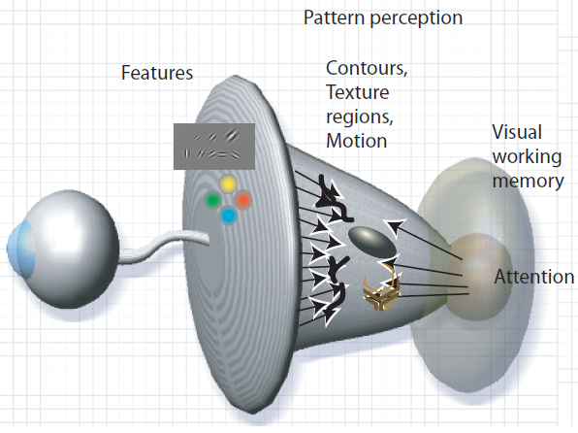
Pattern Finding
Pattern finding:
both top-down and bottom-up processing
Bottom-up: recognition of primitive elements (preattentive)
Top-down: active attention to objects in working memory
Pattern perception:
flexible middle ground where objects are extracted from patterns of features.

Slide 43
Learning
Learning: important role in pattern finding
Short term: priming
see pattern once and it's easy to identify later
Long term: seeing patterns through many trials

Slide 44
Gestalt Laws
Gestalt school of psychology (1912)
gestalt: pattern in German
Max Westheimer, Kurt Koffka, Wolfgang Kohler, and others
1st serious attempt to understand pattern perception
Provided a clear description of many basic perceptual phenomena: Gestalt Laws
"whole is greater (other) than the sum of its parts"

Slide 45
Gestalt Laws
Robust rules that describe the way we see patterns in visual displays
Descriptive theory, but useful
Easily translate into visualization design principles

Slide 46
Gestalt Laws
Gestalt laws:
proximity
similarity
connectedness
continuity
symmetry
closure
relative size
figure and ground
common fate

Slide 47
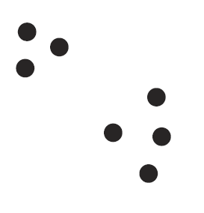
Gestalt Laws - Proximity
Spatial proximity:
powerful cue for perceptual organization
Things closer together are perceptually grouped together
Due to this proximity relationships,
we perceive two groupings of dots here:

Slide 48
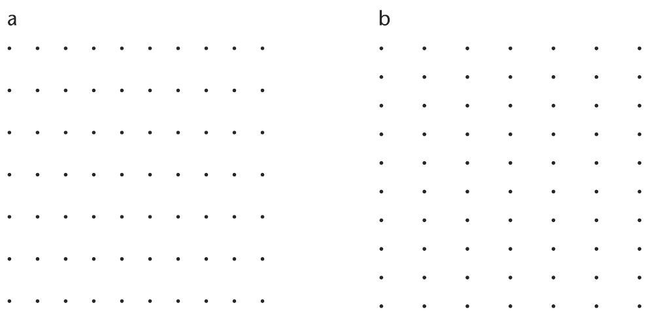
Gestalt Laws - Proximity
Notes:
A matrix of dots is perceived as rows on
the left (a) and columns on the right (b)

Slide 49
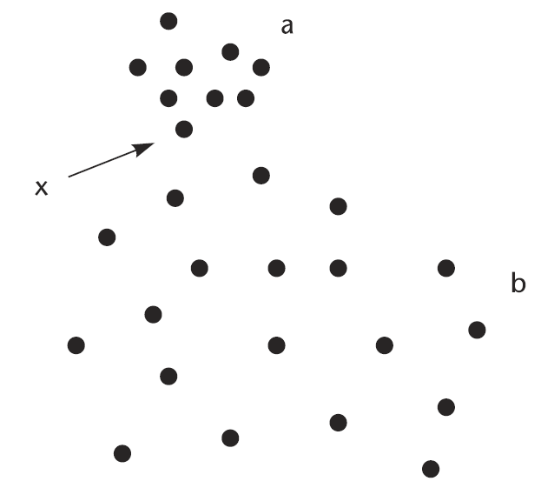
Gestalt Laws - Proximity
The principle of spatial concentration (Slocum, 1983):
we perceptually group regions of similar element density
Notes:
The dot labeled x is perceived as part of group a rather than
group b.

Slide 50
Gestalt Laws - Proximity
Application of the proximity law:
emphasize the relationships between different data entities by placing them in proximity

Slide 51
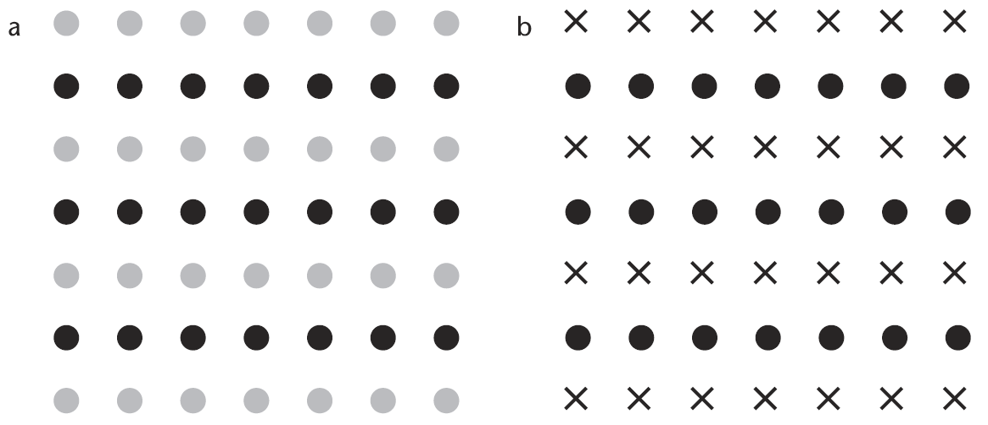
Gestalt Laws - Similarity
Similarity:
similar elements tend to be grouped together
Notes:
According to the Gestalt psychologists, similarity between the elements in alternate rows causes the row percept to dominate.

Slide 52
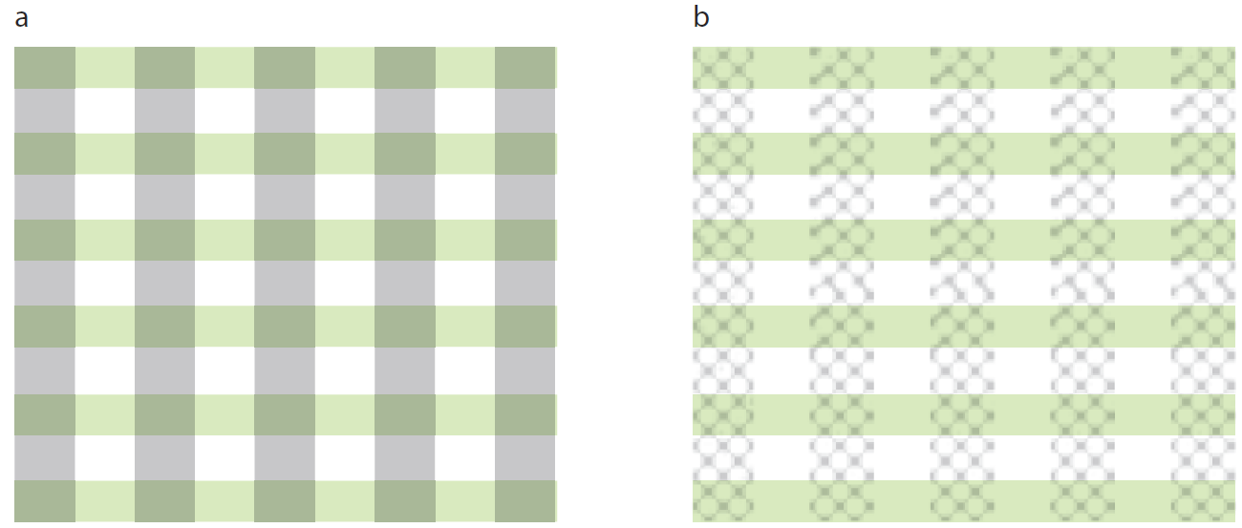
Gestalt Laws - Similarity
Application:
useful if we are designing so that users can easily attend to either one pattern or the other
Notes:
(a) Integral dimensions are used to delineate rows and columns. (b) When separable dimensions (color and texture) are used, it is easier to attend separately to either the rows or the columns.

Slide 53
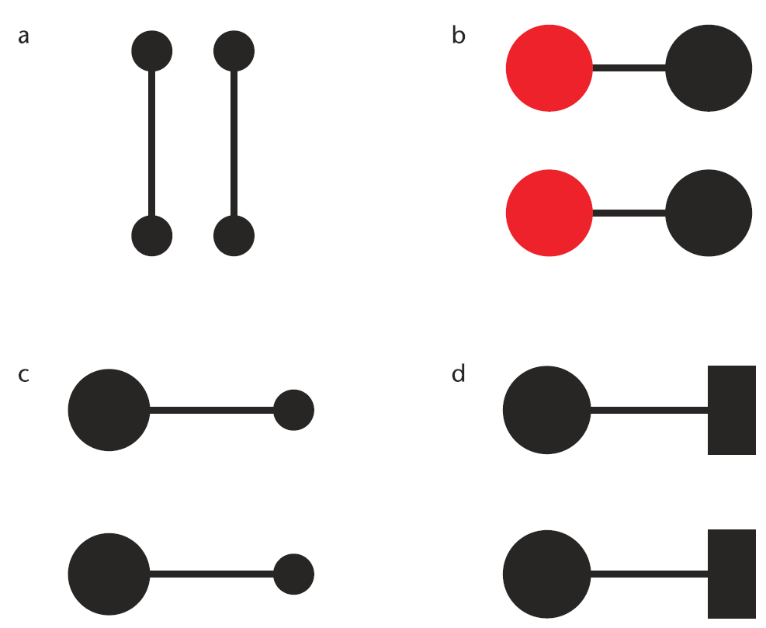
Gestalt Laws - Connectedness
Connectedness (Palmer and Rock - 1994):
fundamental Gestalt organizing principle
that the Gestalt psychologists overlooked
Notes:
Connectedness is a powerful grouping principle that is stronger than (a) proximity, (b) color, (c) size, or (d) shape.

Slide 54
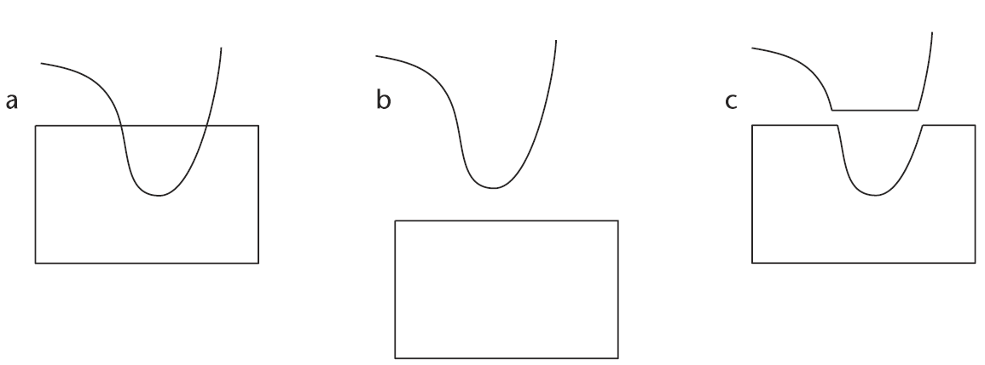
Gestalt Laws - Continuity
Continuity:
more likely to construct visual entities out
of visual elements that are smooth and continuous
(rather than ones that contain abrupt changes in direction)
Notes:
The pattern on the left (a) is perceived as a curved line overlapping a rectangle (b) rather than as the more angular components shown in (c).

Slide 55
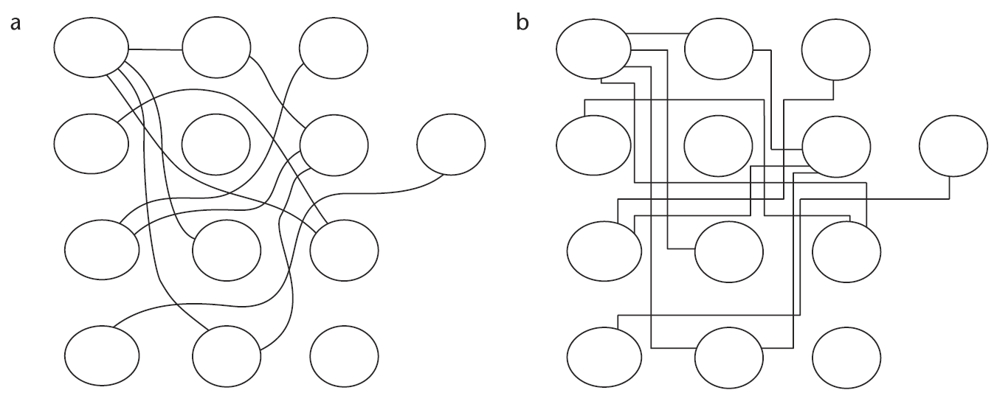
Gestalt Laws - Continuity
Notes:
In (a), smooth continuous contours are used to connect the elements, whereas in (b), lines with abrupt
changes in direction are used. It is much easier to perceive connections when contours connect
smoothly.

Slide 56
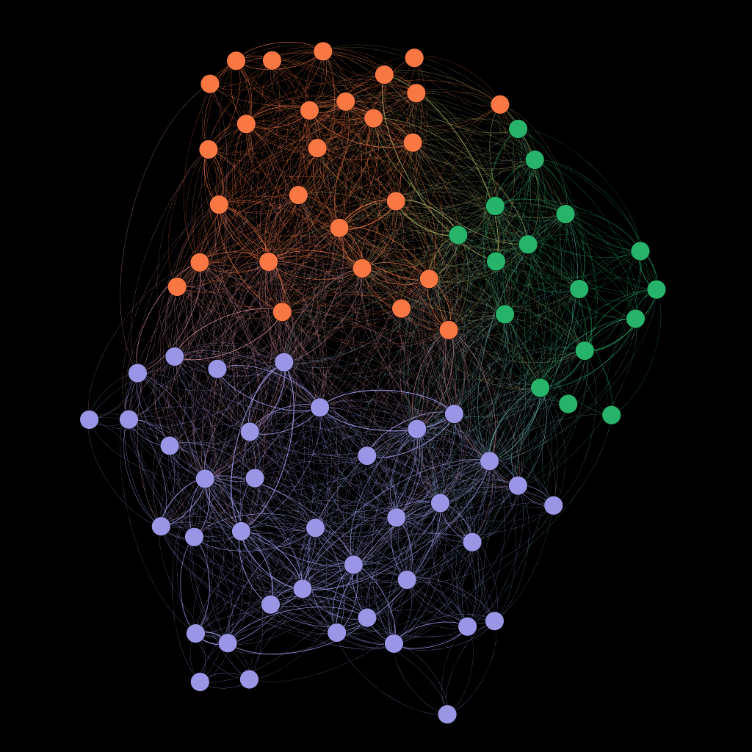
Gestalt Laws - Continuity

Slide 57
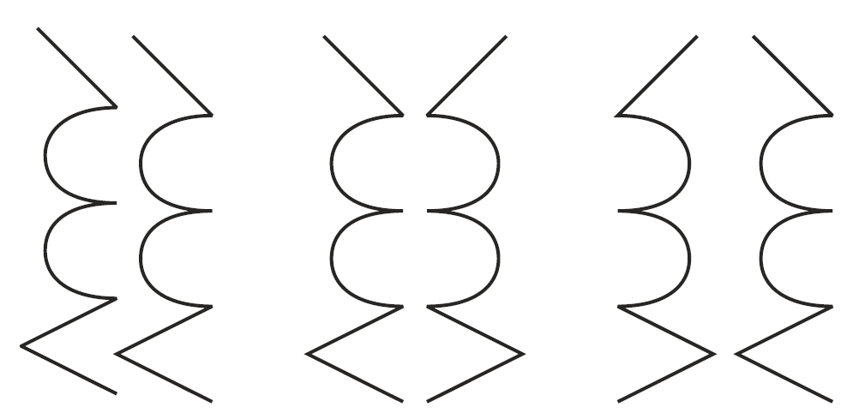
Gestalt Laws - Symmetry
Symmetry:
symmetrical elements are perceived as part of the same group
Notes:
The pattern on the left consists of two identical parallel contours. In each of the other two patterns, one of the contours has been reflected about a vertical axis, producing bilateral symmetry. The result is a much stronger sense of a holistic figure.

Slide 58
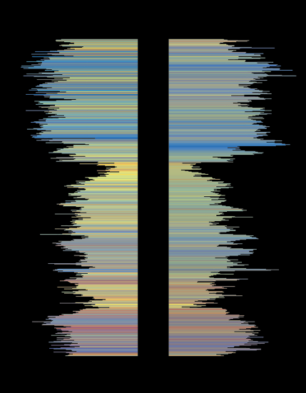
Gestalt Laws - Symmetry
Application: visual analysis of time-series data

Slide 59
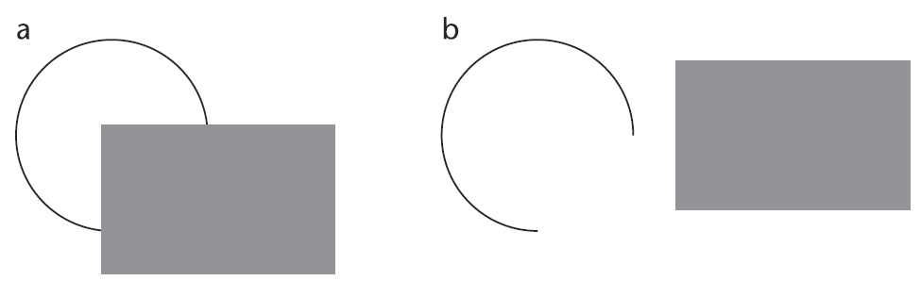
Gestalt Laws - Closure
Closure: a closed contour tends to be seen as an object
Notes:
The Gestalt principle of closure holds that neural mechanisms operate to find perceptual solutions involving closed contours. Hence in (a), we see a circle behind a rectangle, not a broken ring as in (b).

Slide 60
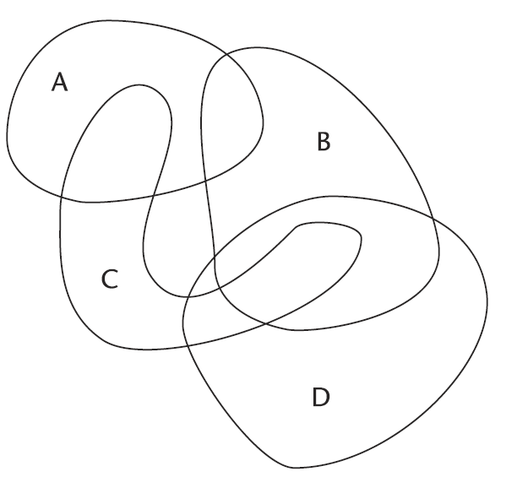
Gestalt Laws - Closure
Example: Euler (or Venn) diagrams

Slide 61
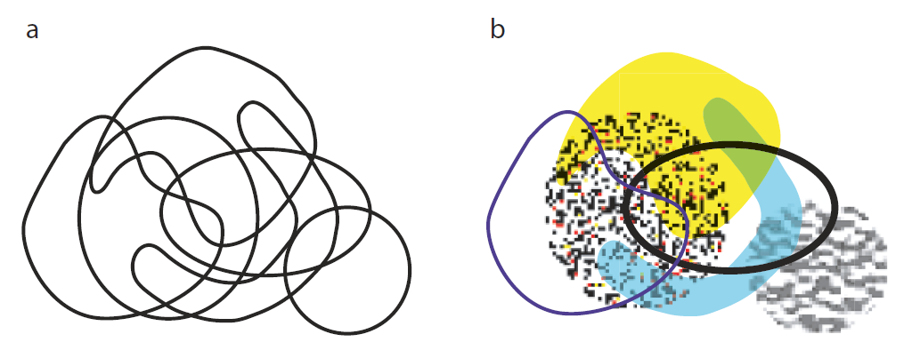
Gestalt Laws - Closure
Notes:
An Euler diagram enhanced using texture and color can convey a more complex set of relations than a conventional Euler diagram using only closed contour.

Slide 62
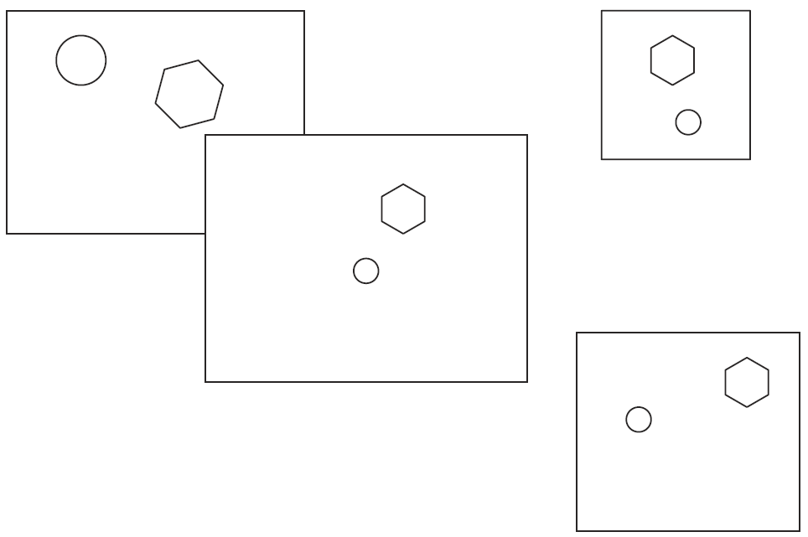
Gestalt Laws - Closure
Example: GUI interfaces (framing)
Notes:
Closed rectangular contours strongly segment the visual field. They also provide reference frames. Both the positions and the sizes of enclosed objects are, to some extent, interpreted with respect to the surrounding frame.

Slide 63

Gestalt Laws - Relative Size
Relative size:
smaller components of a pattern tend to be perceived as objects
Notes:
The black areas are smaller, and therefore more likely to be perceived as an object. It is also easier to perceive patterns that are oriented horizontally and vertically as objects.

Slide 64
Gestalt Laws - Figure and Ground
Figure - perceived foreground object
Ground - perceived background (behind object)
Figure-ground effect:
perceptual tendency to separate whole figures from their backgrounds based on one or more of a number of possible variables, such as contrast, color, size, etc.

Slide 65

Gestalt Laws - Figure and Ground
Notes:
Symmetry, surrounding white space, and a closed contour all contribute to the strong sense that this shape is figure, rather than ground.

Slide 66

Gestalt Laws - Figure and Ground
Notes:
Rubin’s Vase. The cues for figure and ground are roughly equally balanced, resulting in a bistable percept of either two faces or a vase.

Slide 67
Summary
Important to consider visual properties of encodings: color, size, shape, lines, text
Color is perceived based on three primaries
Hue is used for categorical data
Brightness/Saturation is good for representing ordered data
Understanding perception of color is key to choosing suitable representations
Size encoding allows for comparison of areas - can encode continuous quantities

Slide 68
Summary (cont.)
Text is important, but needs to be selectively used and readable
Shape can encode large number categories
Lines can represent all sort of relationship (can vary by other visual properties)
Legends are good when many data points need to be labeled. Otherwise, use direct labeling.
Gestalt Laws help to guide good design choices by describing how humans see patterns
Some Gestalt laws include: proximity, similarity, continuity, closure, and figure and ground

